Slide 1
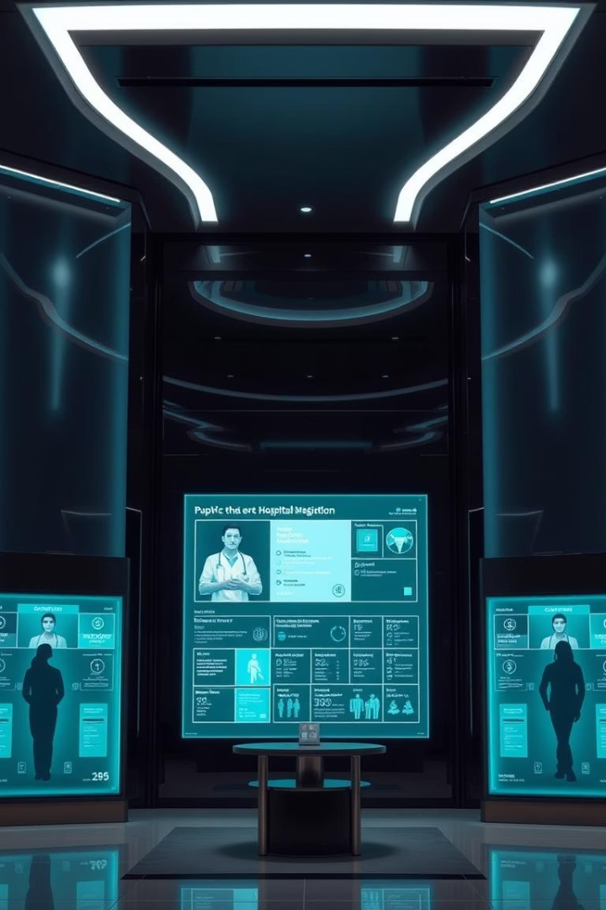

CPRM - Key System Interfaces
This presentation details critical interfaces within the CPRM system. We will explore how these components integrate to enhance patient care and operational efficiency.
by 928 Gauresh

Slide 2
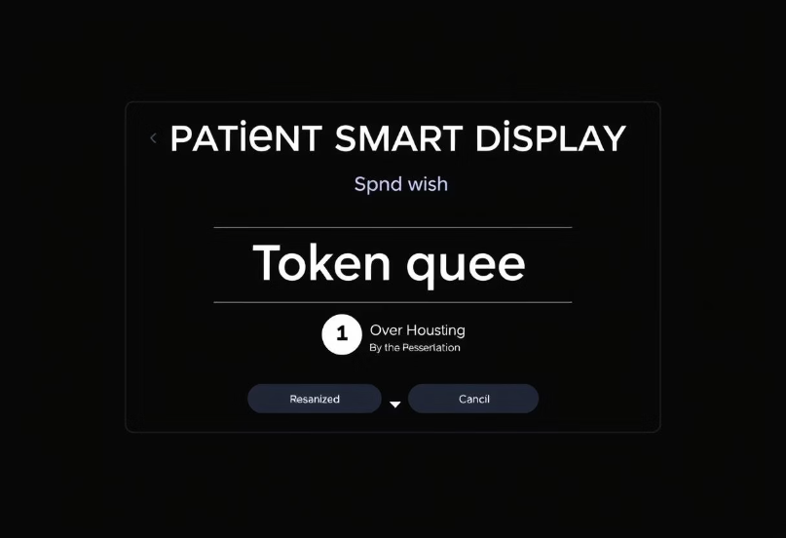
Smart Display System: Personalized Information Delivery
Patient-facing smart displays offer personalized, dynamic information. They manage token queues and broadcast emergency alerts in real-time. This system ensures patients receive relevant updates promptly.
Personalized content based on location.
Dynamic token queue management.
Multi-dashboard rotation system.
Emergency alert broadcasting.
Real-time system health monitoring.

Slide 3





Efficient Queue Management
Department-specific queues
Manage patient flow per department.
Real-time wait estimates
Provide accurate patient waiting times.
Automatic priority sorting
Organize queues by urgency.
Color-coded status
Visual indicators for quick assessment.
Our smart display system intelligently manages patient queues. It offers department-specific token systems, real-time wait estimates, and automatic priority sorting. Color-coded status indicators enhance clarity for both patients and staff.

Slide 4
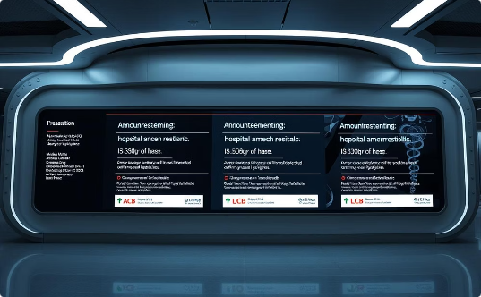
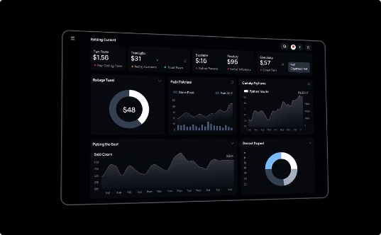
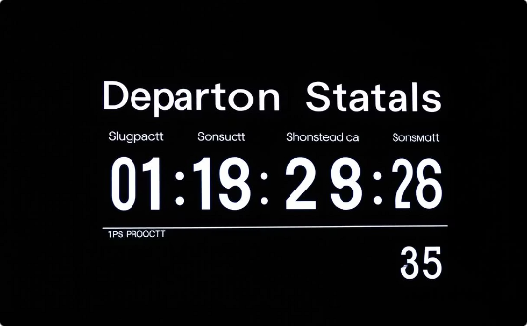
Dynamic Content and Announcements
Location-relevant announcements
Auto-rotating content sections
Department status insights
Current patient counts per department.
Tailored messages for specific areas.
Dashboards rotate every 15 seconds.
The displays dynamically present content to keep patients informed. This includes location-relevant announcements, automatically rotating content sections, and live department status with patient counts. This ensures up-to-date and contextual information delivery.

Slide 5




Critical Alert Broadcasting
Instant emergency notifications
Immediate alerts with location data.
Code Blue/Red priority
Critical alerts display with high priority.
Automatic content interruption
Critical alerts override regular content.
Staff response coordination
Information for staff action.
The system prioritizes critical alerts. It broadcasts instant emergency notifications with location data, highlights Code Blue/Red priorities, and automatically interrupts content for critical messages. This facilitates rapid staff response coordination during emergencies.

Slide 6

Privacy-Focused Patient Identification
Contextual emergency information
Privacy-focused identification
Relevant details for emergencies.
Patient data displayed securely.
Operating theater status
Procedure progress updates.
Patient privacy is paramount. The system provides contextual emergency information without compromising patient identification. It also displays operating theater status, including procedure progress, while maintaining strict data security protocols.

Slide 7

Real-Time System Health Monitoring
5
24/7
1
Second Refresh Intervals
Heartbeat Monitoring
Offline Detection
Display uptime assurance.
Immediate reporting.
Latest data updates.
100%
Automatic Recovery
Ensures continuous operation.
System health is continuously monitored to ensure reliability. Displays refresh every 5 seconds for the latest data. Heartbeat monitoring confirms display uptime. Offline detection and reporting trigger automatic recovery mechanisms for uninterrupted service.

Slide 8








Key Takeaways and Next Steps
Enhanced Security
Increased Efficiency
Robust data protection features.
Streamlined operations and patient flow.
Future Integrations
Improved Patient Experience
Expand system capabilities.
Personalized and timely information.
The CPRM system offers enhanced security and efficiency, significantly improving the patient experience through personalized information. Our next steps involve exploring further integrations and expanding system capabilities to meet evolving healthcare needs.

